Slide 1
The Denver Housing Market
or, Where Should I Move?
John Francis Ryan, Ph.D.
jfryan70@gmail.com

Slide 2
Purposes of Project
a.k.a. Why do this?

Slide 3
Imagine Someone:
New to Denver area
House hunting
Where to live, and why?

Slide 4
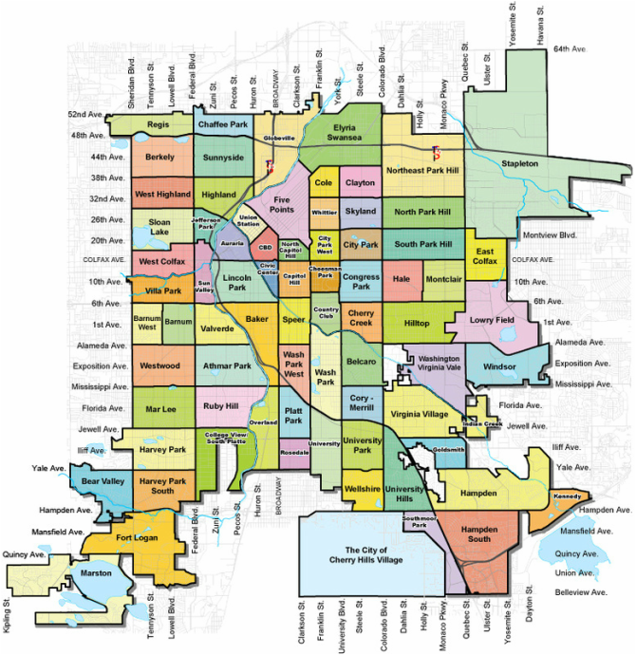
Visualize Neighborhoods
Become familiar
‘See’ the neighborhoods

Slide 5

Understand Housing Market
Market
Highs/Lows
Neighborhoods
Forces

Slide 6
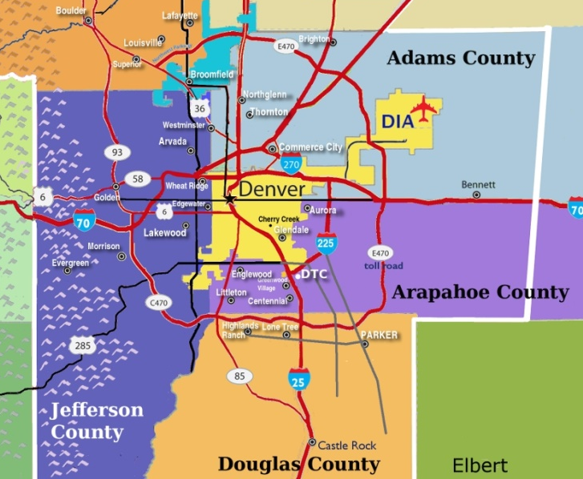
Five-County Denver Metropolitan Area
Counties:
Adams
Arapahoe
Denver
Douglas
Jefferson
Including full counties

Slide 7
Steps
Data Sources
Housing Market
Possible Factors
What Drives Housing

Slide 8
Data Sources

Slide 9
Data Should Be
Reliable
Useful
Neighborhood Level

Slide 10
Data Sources
Census Data
School Data
American Community Survey
Annual Survey
Neighborhoods
Demographics
Schooldigger.com
Student achievement
District level
State rankings

Slide 11
Potential Forces
Housing Values
Housing
Area
Neighborhood Demographics
School
Quality

Slide 12
Categories
Neighborhood
Age
Income/education
Families
Poverty
Housing Area
School Quality
Median age
Vacancies?
Renting?
Poverty
State ranking
Past year
Two years ago

Slide 13
Housing Values
Neighborhood median
Self-reported
Not final selling price
Matching Census data
Five-county area

Slide 14
Important Limits
Housing values
See above
Macro-level data
Individual surveys
Not micro-level behavior
Five-county area
Not just Denver city limits
All of each county

Slide 15
Neighborhood Insights

Slide 16
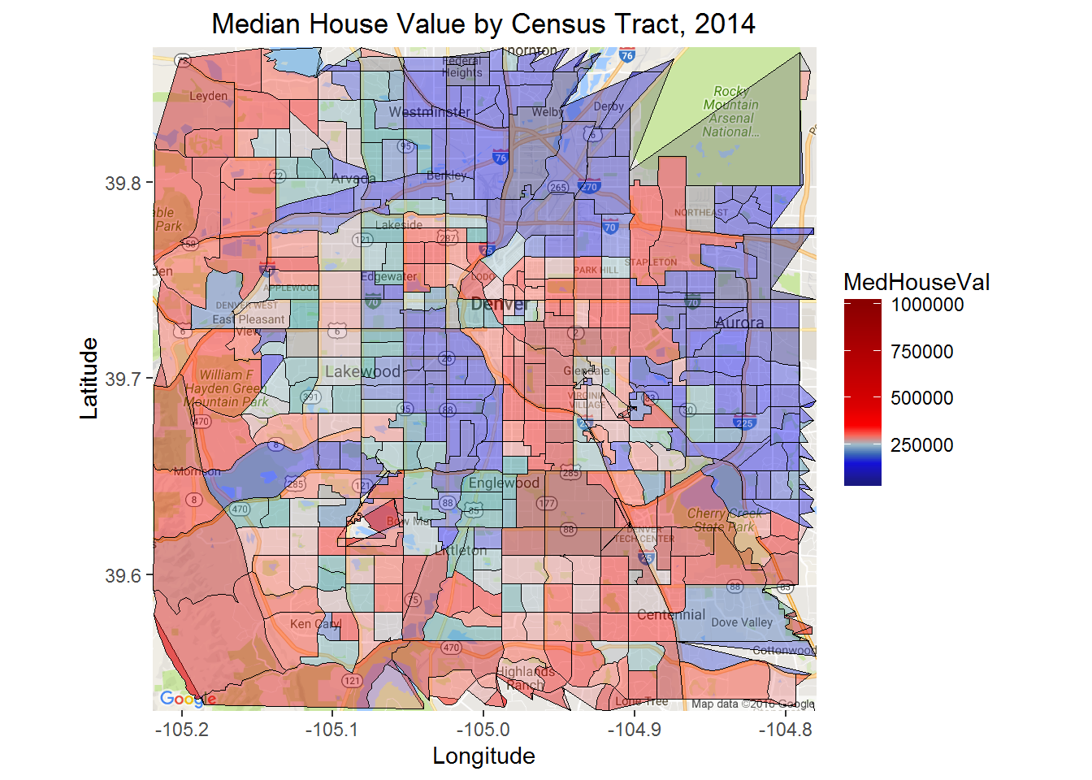
Median housing

Slide 17
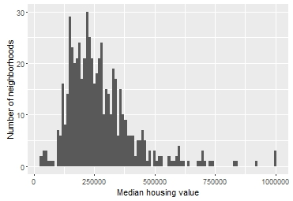
Wide range of neighborhoods
Fairly bell-shaped
Max. $1,000,000+
Min. $27,500
Median: $243,100
50 percent within
$181,900 to
$331,000

Slide 18
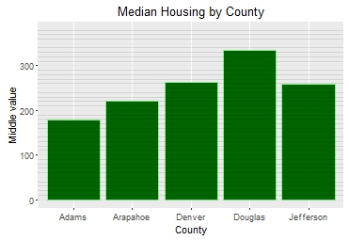
Douglas County most expensive
Douglas: $334,400
Adams: $179,350
Other three:
$221,700 to
$262,700

Slide 19
Top 20 Neighborhoods, 2014
Arapahoe: 45%
Denver: 30%
Douglas and Jefferson: 25%
Areas:
Cherry Hills
Greenwood
Littleton
Cherry Creek

Slide 20
Bottom 20 Neighborhoods, 2014
Adams: 60%
Arapahoe: 30%
Areas:
Federal Heights
Thornton
Aurora

Slide 21
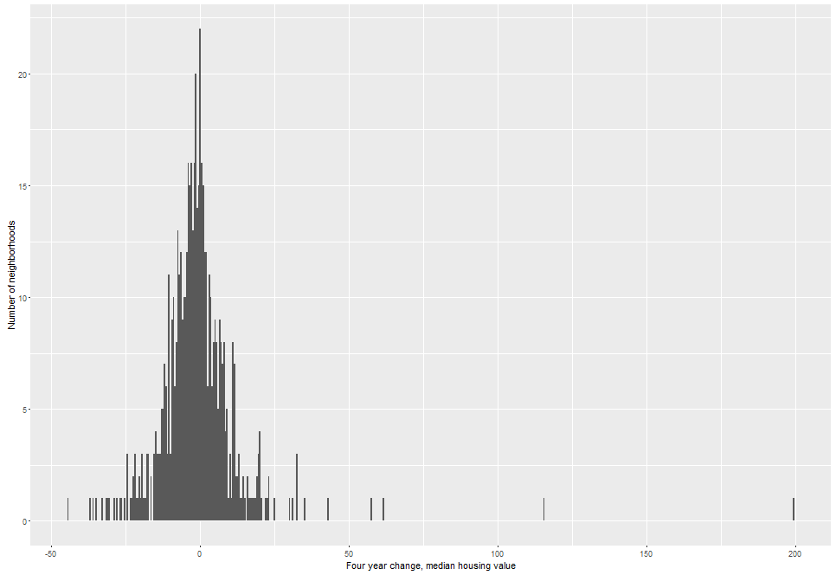
Slight decline in housing values, 2010-2014
Fairly bell-shaped
Best: +199%
Worst: -44%
Median: -1.7%
50 percent within
-7.2% to
+3.57%

Slide 22
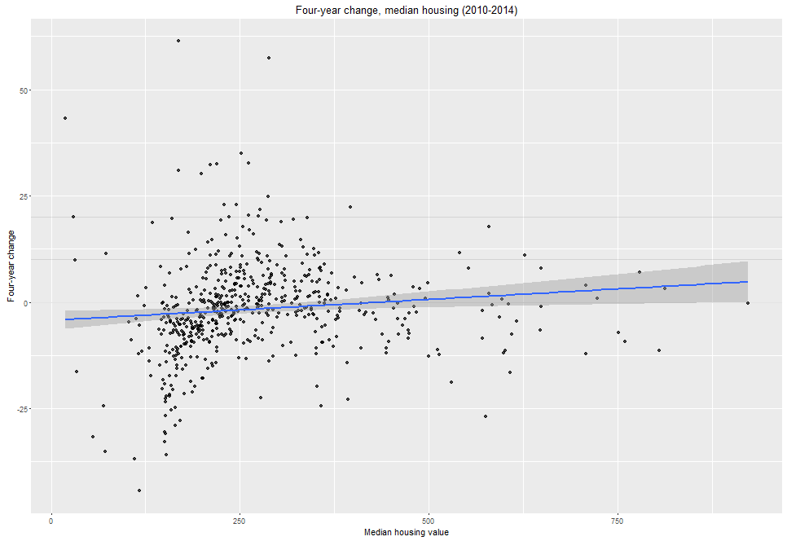
Decline fairly uniform
Affluent neighborhoods affected
Overall, negative
Worst: -44%
Median: -1.7%
50 percent from
-7.2% to +3.6%
Notes:
Removed two $1,000,000 neighborhoods since cannot calculate
Removed two highest values (100%)

Slide 23
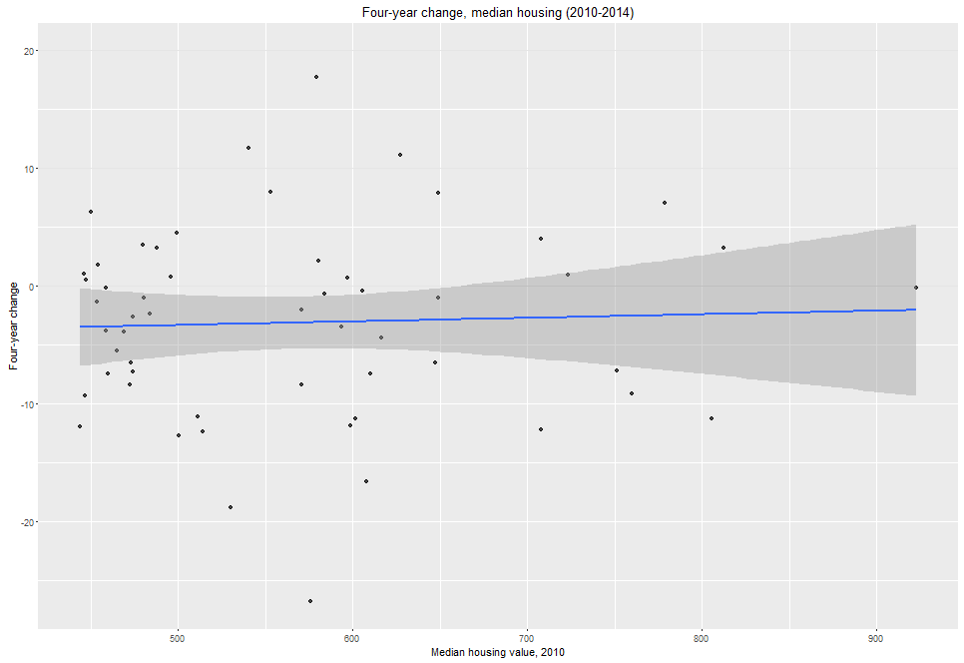
Slight four-year decline among top 10% most expensive (2010)
Fairly spread out
Slight decline as general pattern
Best: +17.7%
Worst: -26.8%
Median: -2.4%
Notes:
Removed two $1,000,000 neighborhoods since cannot calculate

Slide 24
Top Growth Areas
Denver: 60%
Arapahoe: 15%
Tops in Adams
Jefferson, Douglas not here
Mature mkts?

Slide 25
Biggest Decline Areas
Adams, Arapahoe, Denver dominate
One in Jefferson
No Douglas
Mostly lower-end neighborhoods

Slide 26
Possible Factors

Slide 27
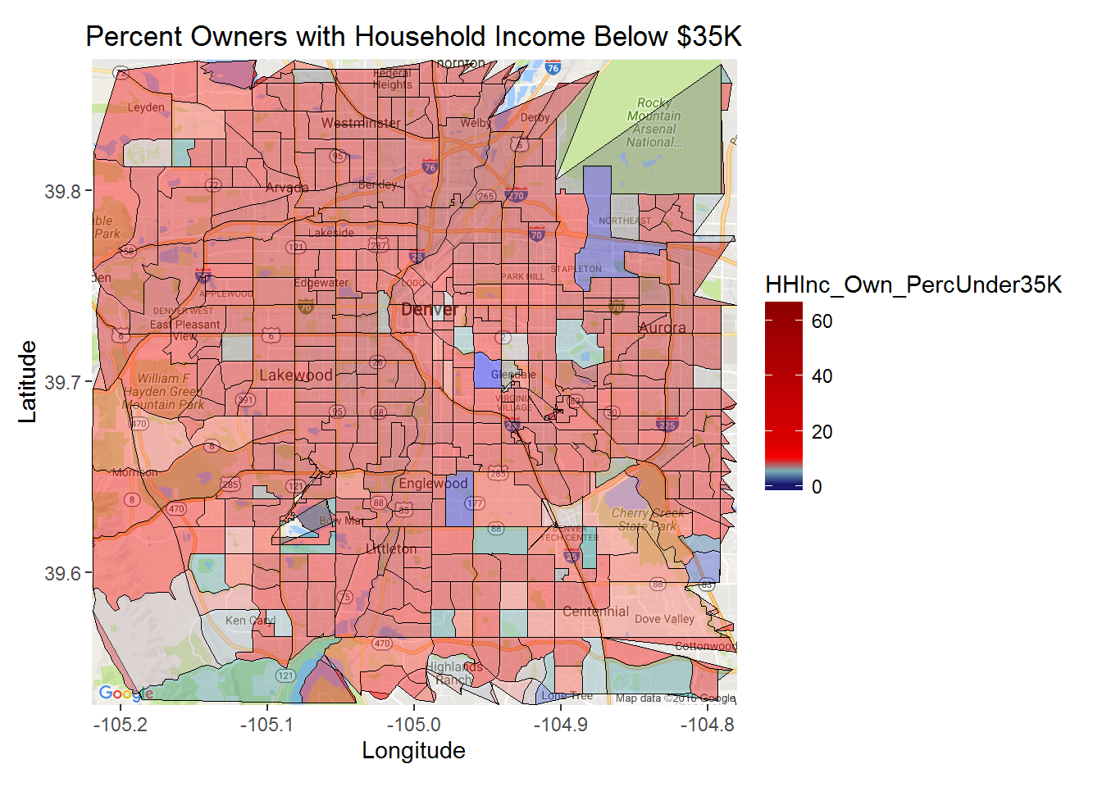
Lower household income

Slide 28
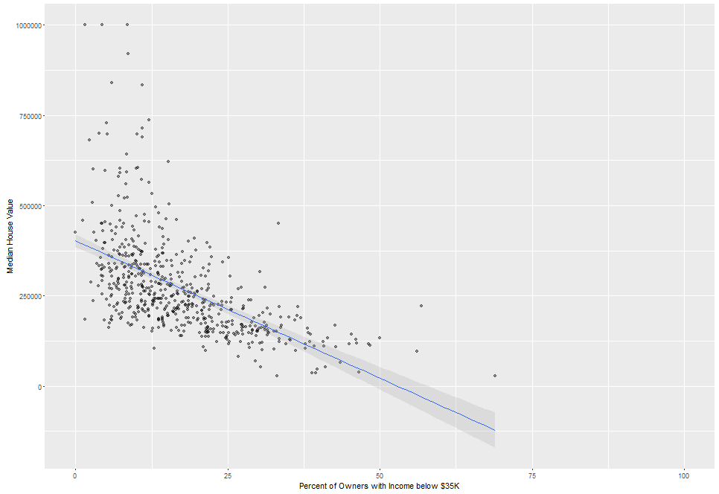
Low household income: negative relation
Percentage below $35K:
Everyone
Owners only
Correlations
All: -0.52
Owners: -0.56

Slide 29
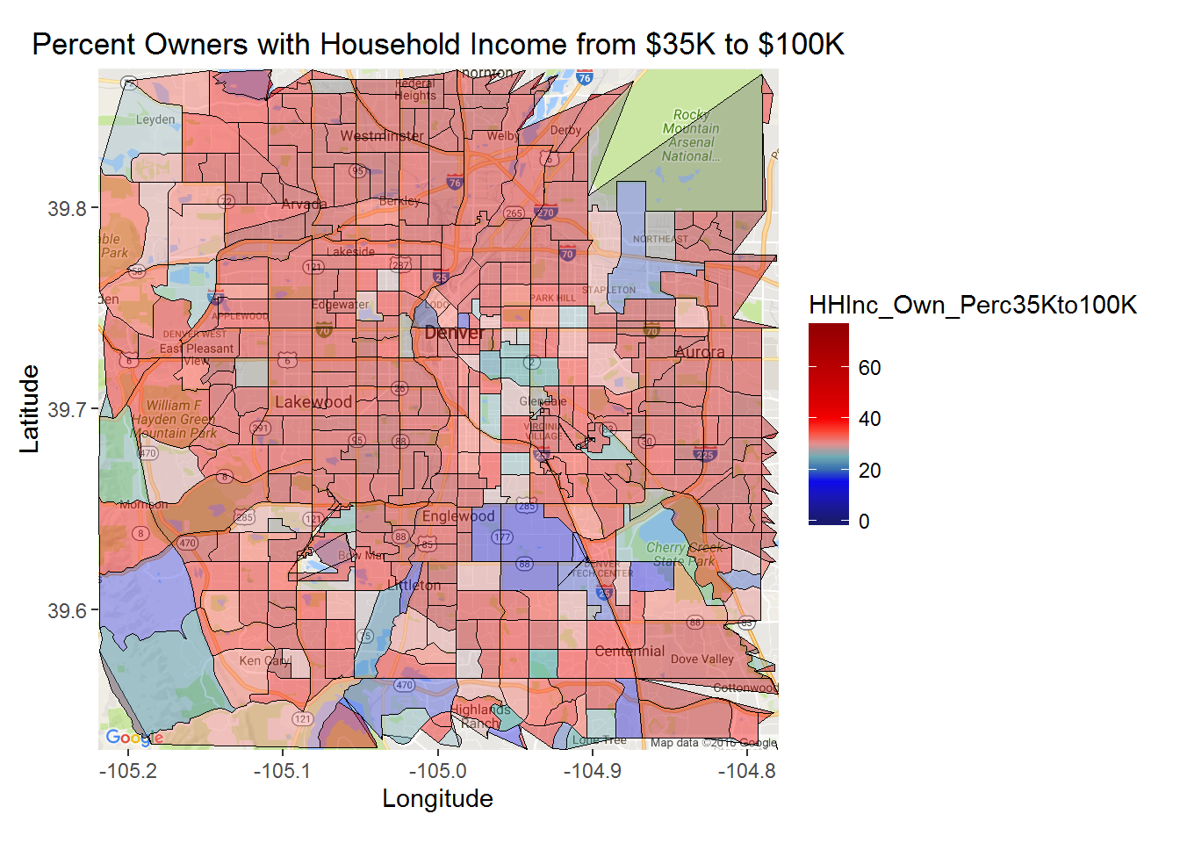
Middle-class household income

Slide 30
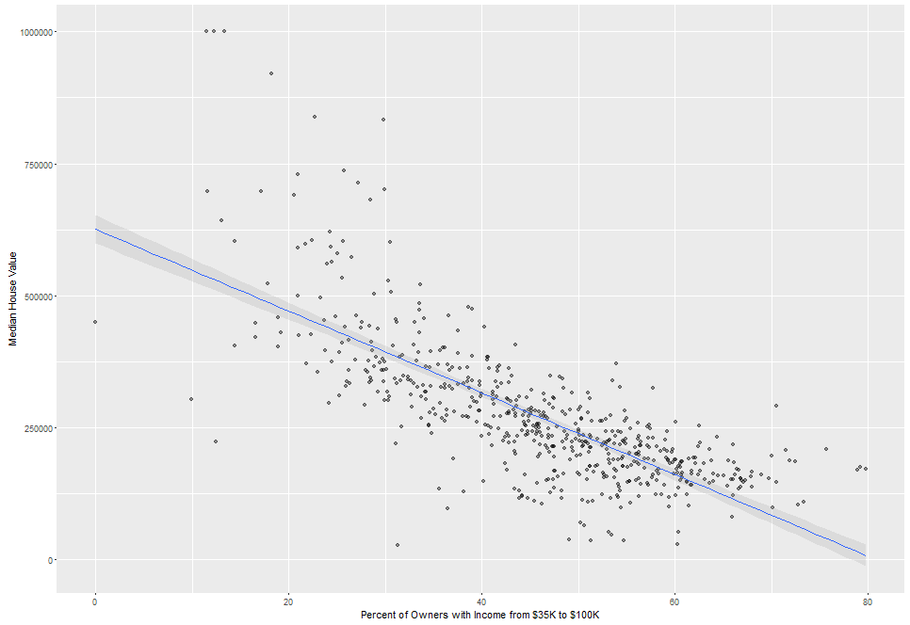
Middle-class household income negative?
Percentage from $35K to $100K:
Same as before
CO ‘middle-class’
Correlations
All: -0.64
Owners: -0.74
Other correlations:
$35-50K: -0.57
$50-75K: -0.50
$75-100k: -0.05

Slide 31
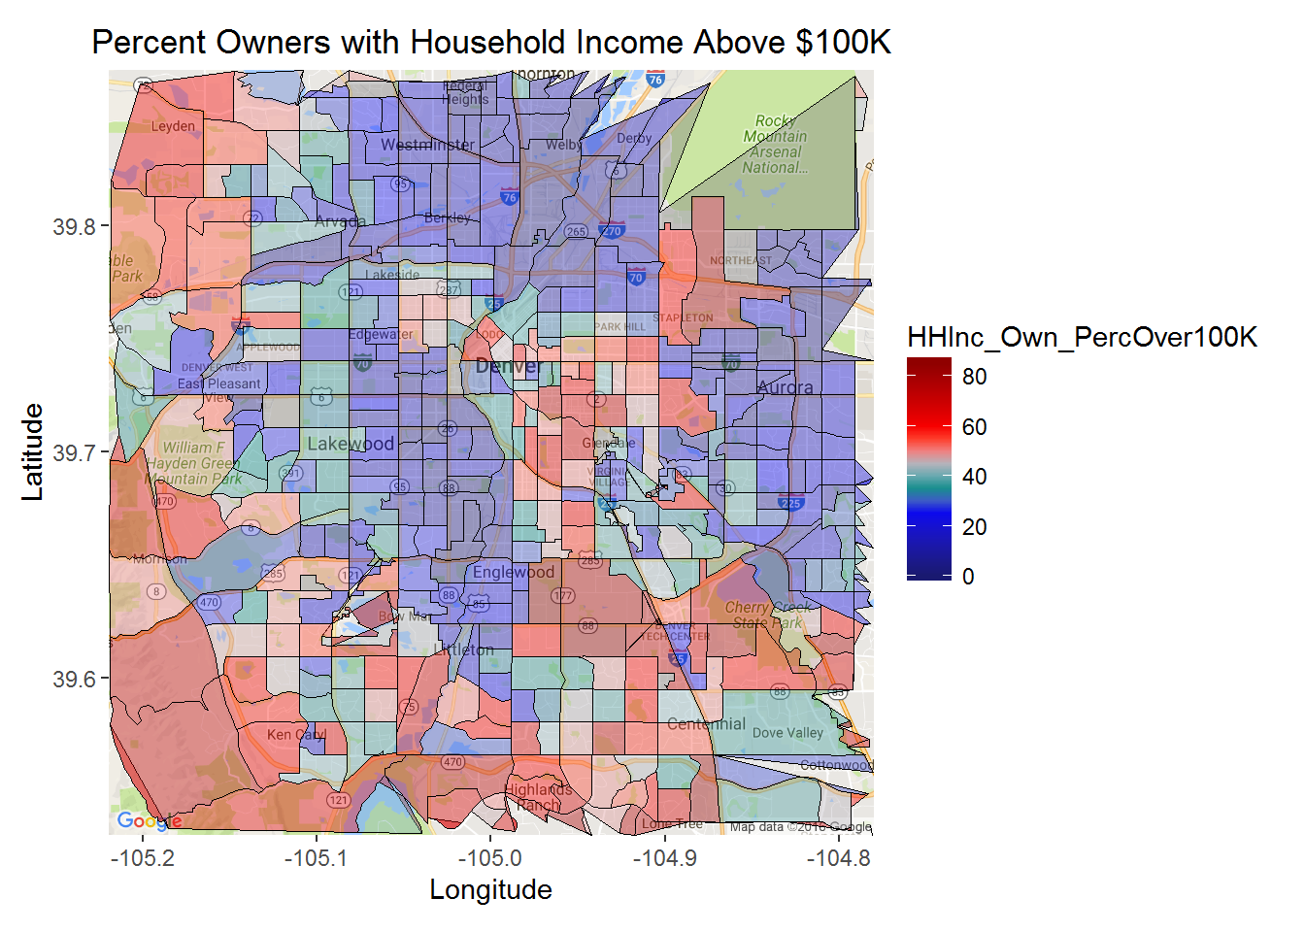
Upper household income

Slide 32
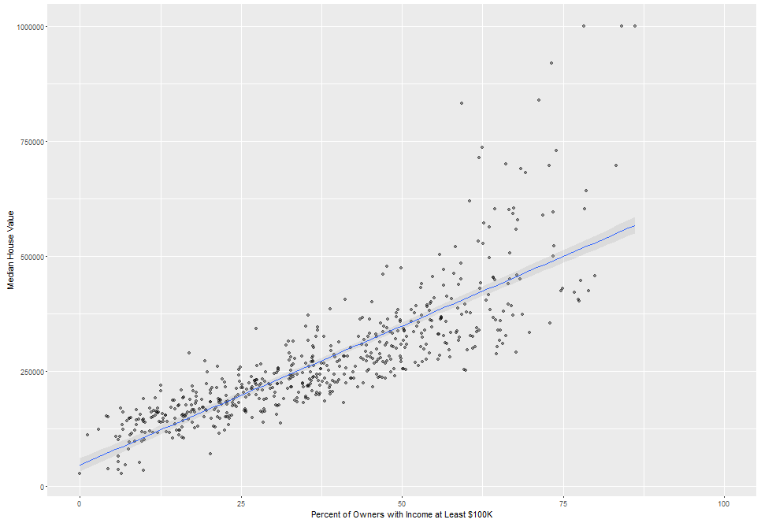
Upper household income positive
Percentage above $100K:
Same as before
Correlations
All: 0.76
Owners: 0.82
Other correlations:
$35-50K: -0.57
$50-75K: -0.50

Slide 33
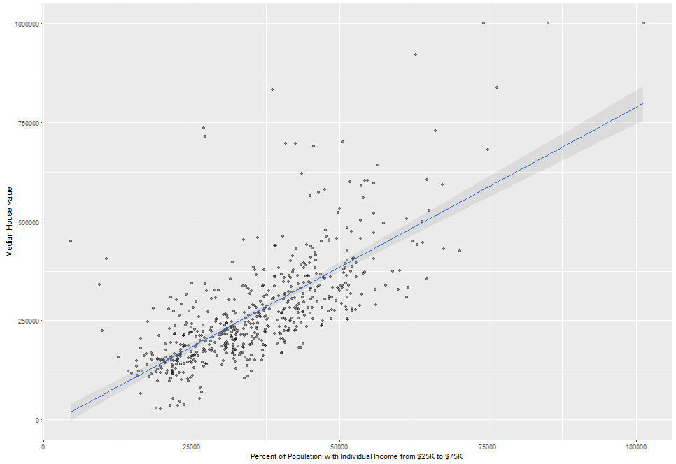
Neighborhood individual income: positive relation
Median income, neighborhood
Correlation: +0.72
Correlations with
percent:
Below $25K: -0.54
$25-35K: -0.57
$35-50K: -0.37
$50-65K: +0.06
$65-75K: +0.20
$75K+: +0.82

Slide 34
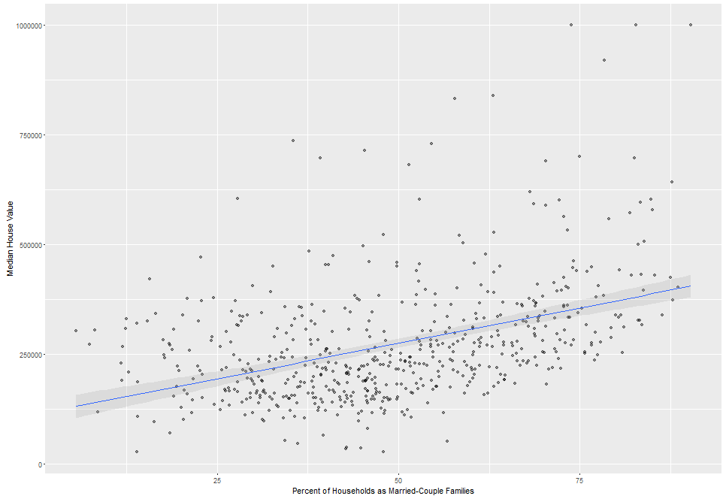
Family factors: modest relation
Family factors:
Percent married couples
Average family size
Correlations:
Percent married couples: +0.42
Average family size: -0.35

Slide 35
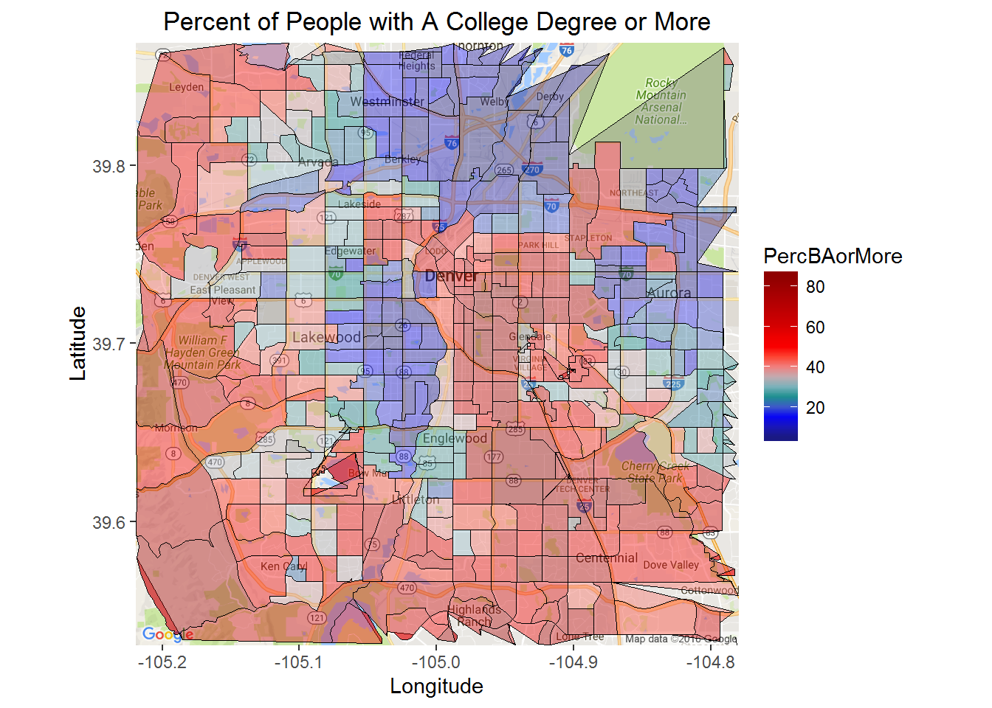
Neighborhood education

Slide 36
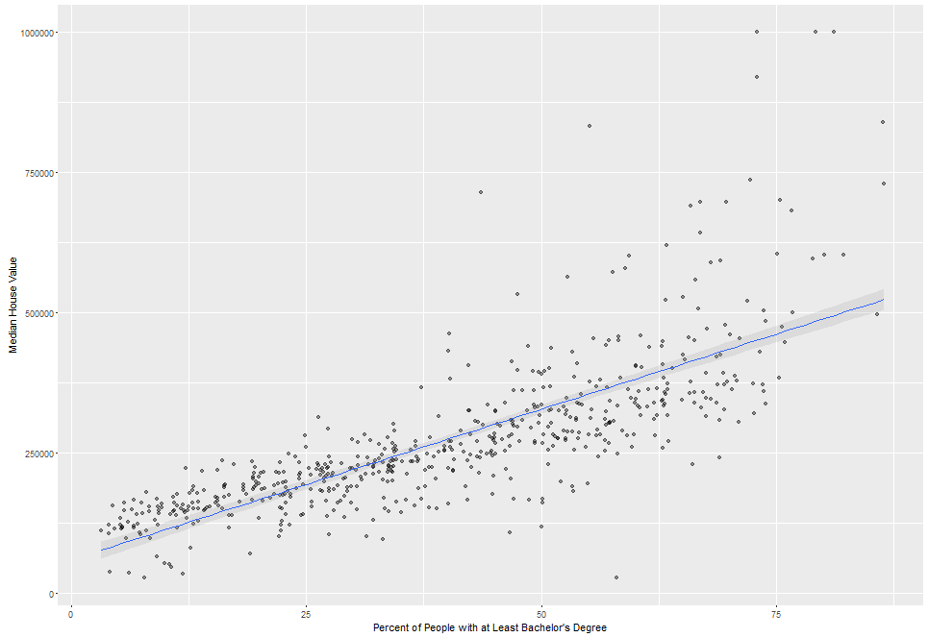
Neighborhood education: very important
Adult education levels (percent)
Correlations with
percent:
HS dropout: -0.53
HS only: -0.69
Some college or Assoc.: -0.40
BA only: +0.67
Degree above BA: +0.80
HS or more: +0.53
BA or more: +0.77

Slide 37
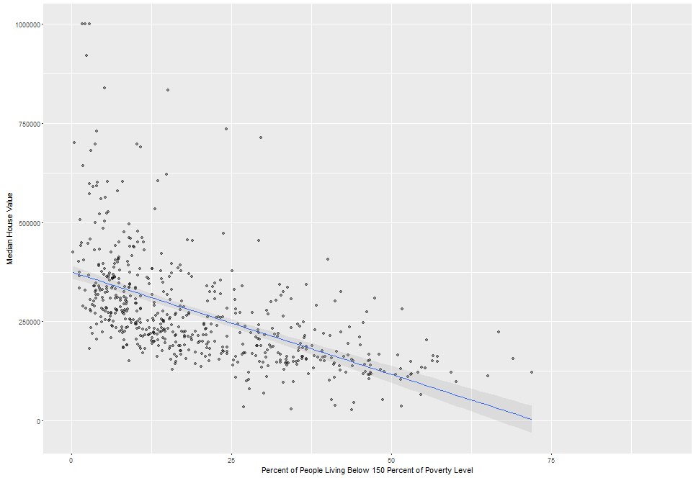
Poverty rates: negative relation
Percent of people:
Poverty rate
Up to 150 perc. poverty rate
Correlations:
Poverty: -0.47
150 percent poverty: -0.55

Slide 38
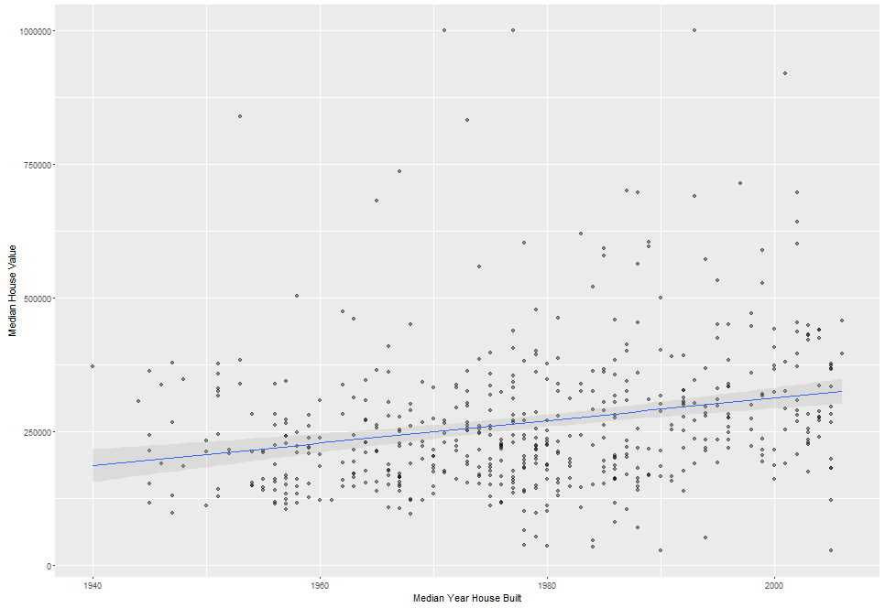
Housing age and size: minimal relation
Housing:
Median year built
Percent at least two-units
Correlations:
Year: +0.24
Unit size: -0.19

Slide 39
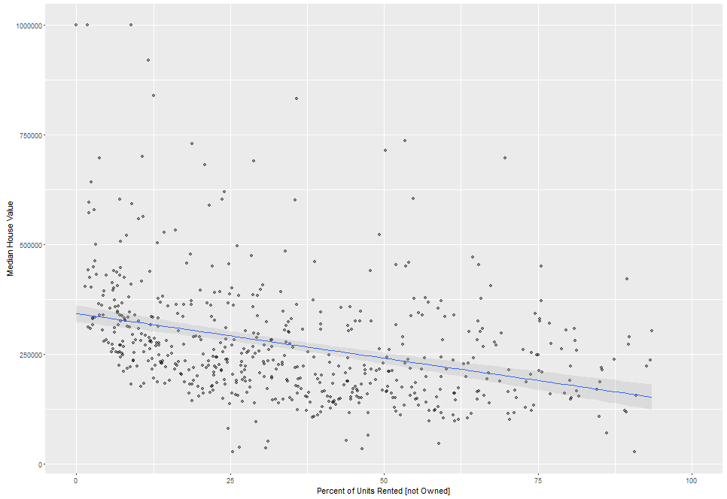
Housing vacancies & renting: minimal relation
Housing:
Percent vacant
Percent rented
Correlations:
Vacant: -0.04
Rented: -0.34

Slide 40
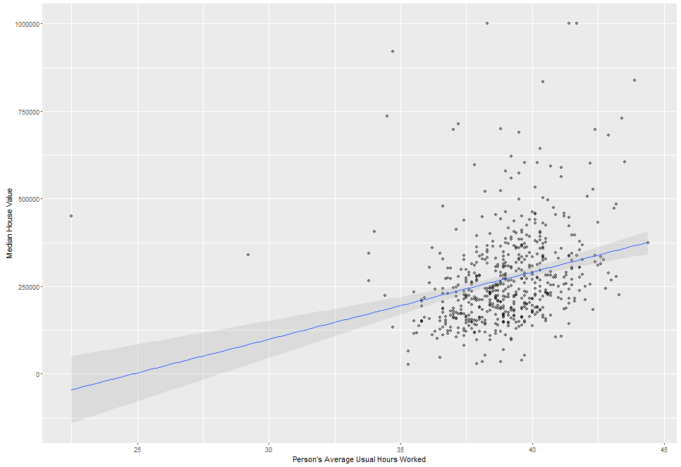
Neighborhood working: minimal relation
Neighborhood working:
Average number of hrs. worked
Correlation of +0.26

Slide 41
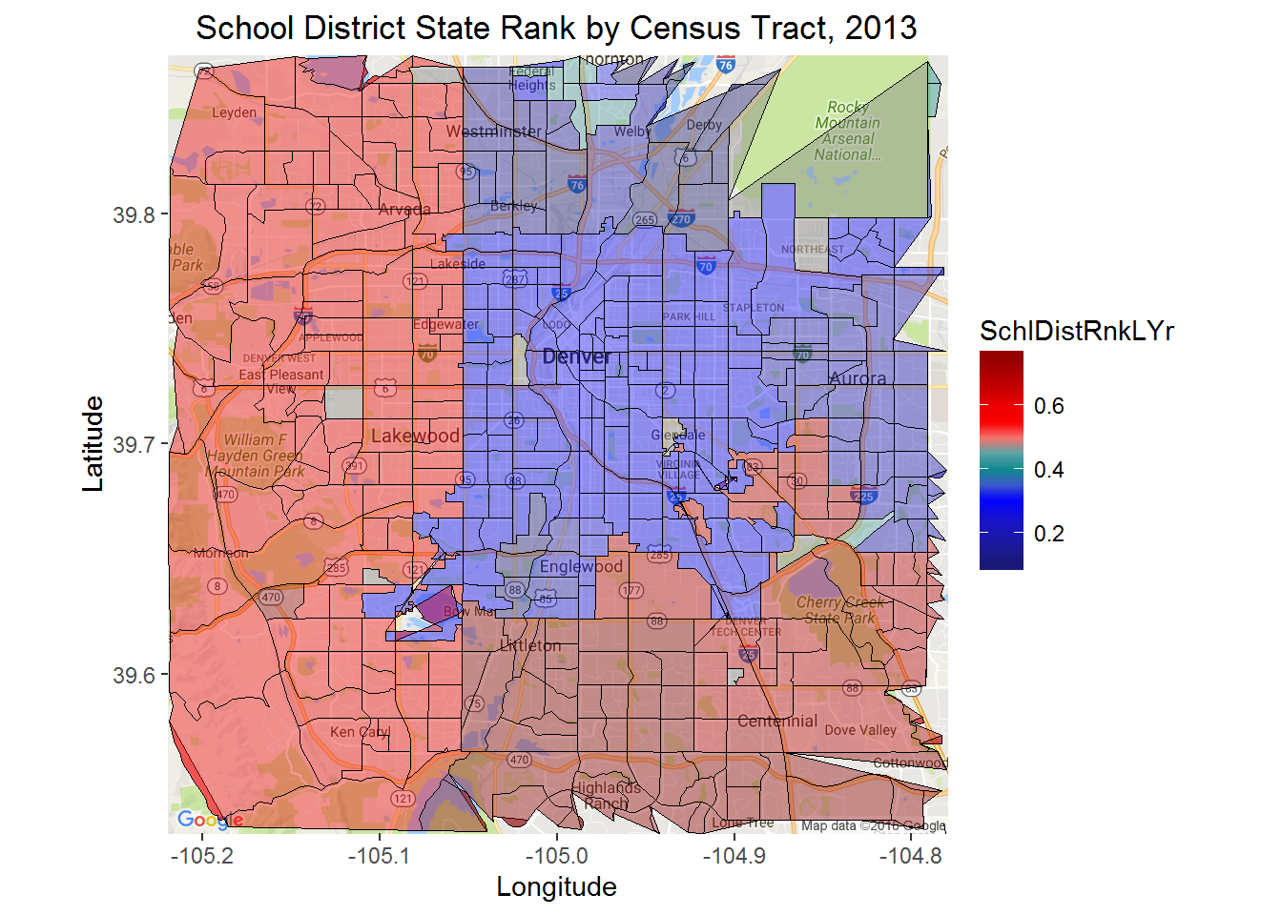
School district quality

Slide 42
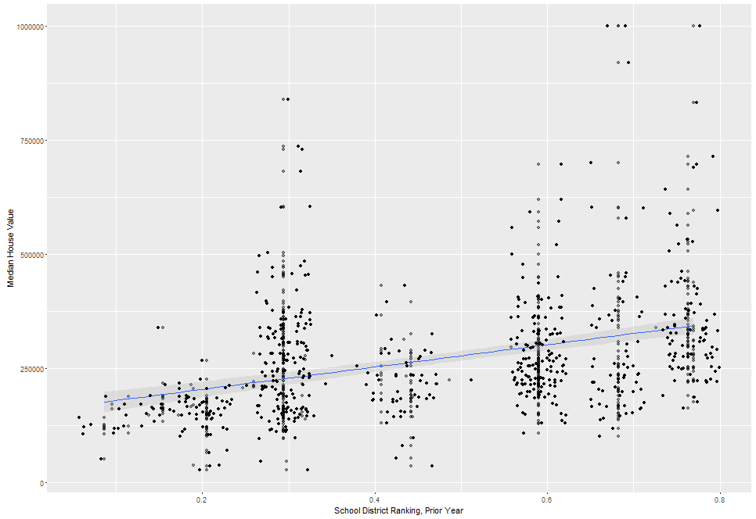
School district quality: modest relation
School district rank:
Prior year
Two years ago
Correlations:
Prior yr: +0.37
Two years ago:
+0.35
School districts much larger than neighborhoods

Slide 43
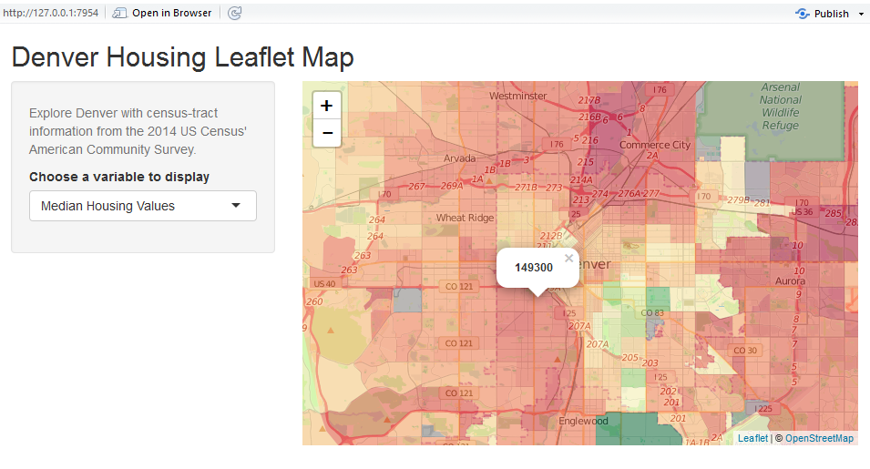
Interactive map: github.com/JohnRyan70/Denver_Housing/tree/master/Shiny

Slide 44
What Drives Housing

Slide 45
Potential Factors
Housing Values
Housing
Area
Neighborhood Demographics
School
Quality

Slide 46
Potential Factors
Housing Values
Vacancies
Poverty Rate
Age/income
Education
Families
District Rank,
Statewide

Slide 47
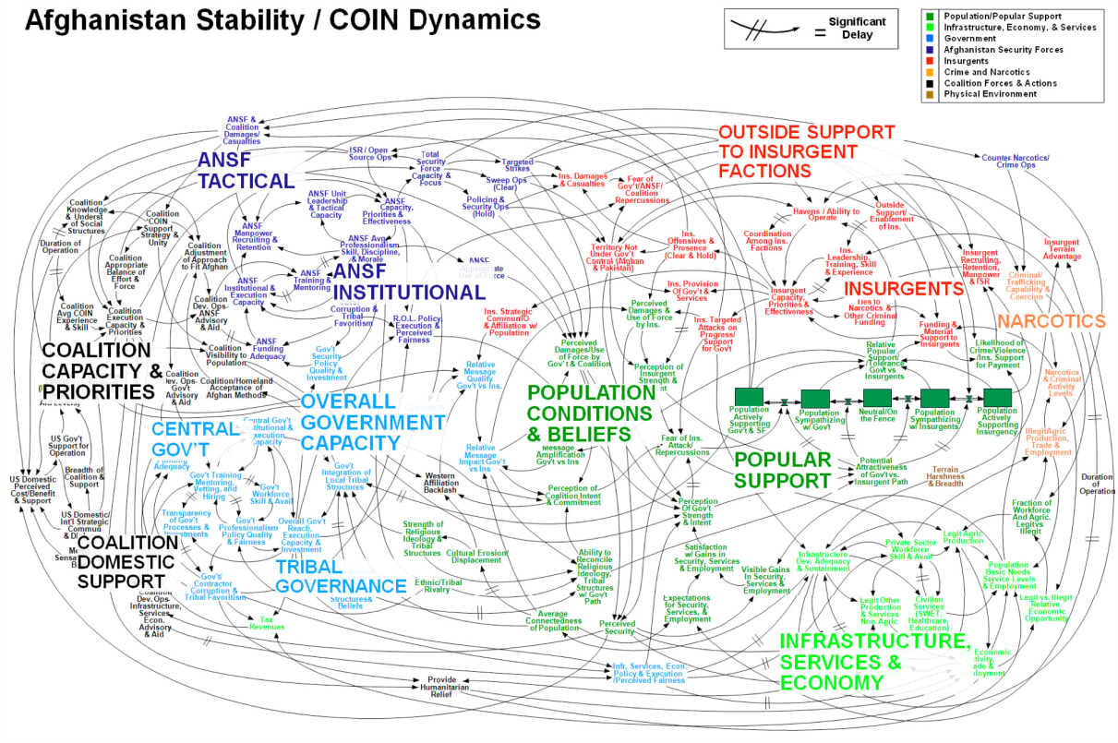
Choosing Model
Model:
Predict vs. interpret
Easy to explain
Reduce overfitting

Slide 48
Finding Best Model
LASSO regression
Reduce multicollinearity
Select factors
Cross-validation
‘Train’ model on 70%
Then test dataset (30%)
Model results
Similar RMSE to OLS
RMSE 7.4% higher, test data
Dropped two variables

Slide 49
Income and education important
Household income
From 20% to 60%: $176K!
Individual income:
Every $1 as $1.50 housing
VIF over 8 in some cases
College education:
From 20% to 60%: $97K!

Slide 50
Surprises
High school dropouts positive?
‘Middle-class’ households gone
Poverty rates positive?
School districts negative?
Vacancies positive?

Slide 51
Recommendations
a.k.a. Why do this?

Slide 52
Check neighborhood income
Household owners
High-income strong!
Middle-income so-so
Individual income important
Multiplier effect
Negative for below $35K
Positive above $75K
Middle-income so-so

Slide 53
Check education levels
College education strong
Positive relation
Higher with post-college
High school dropouts mixed
School districts mixed
District size
Perhaps individual schools

Slide 54
The End
Questions?

Slide 55
John Francis Ryan, Ph.D.
jfryan70@gmail.com
254-230-2555
www.about.me/john.f.ryan

Slide 56
Technical Details
Modeling process

Slide 57
Initial Problems
OLS Regression
Multicollinearity
VIF over 8 in some cases
Some factors related

Slide 58
LASSO Regression
Least Absolute Shrinkage and Selection Operator
Here, k-fold cross-validation
“Tuning parameter”
Collinearity
Variable selection

Slide 59
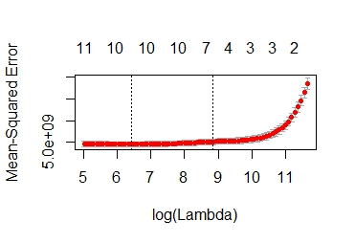
Tuning parameter (lambda)
Minimum: 617.1
One std. err.: 65880.1

Slide 60
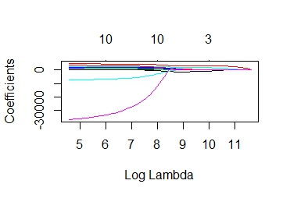
Tuning parameter (lambda)
Lambda large enough: everything is zero
Some variables shrink

Slide 61
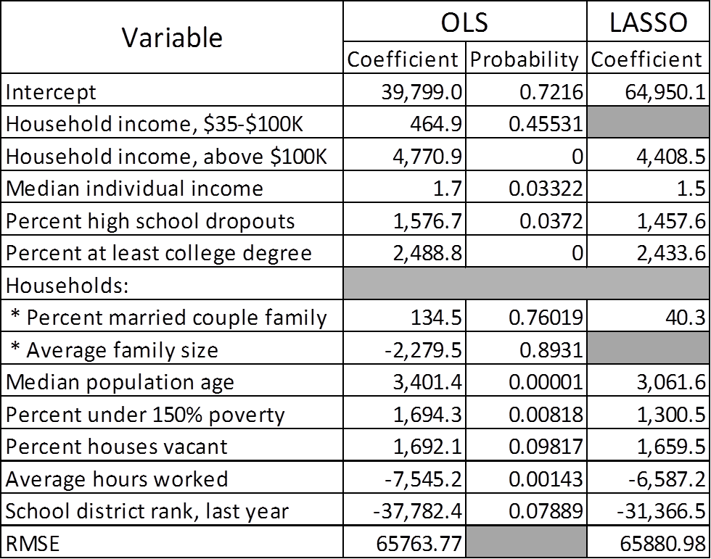
Model Results

